Slide 1
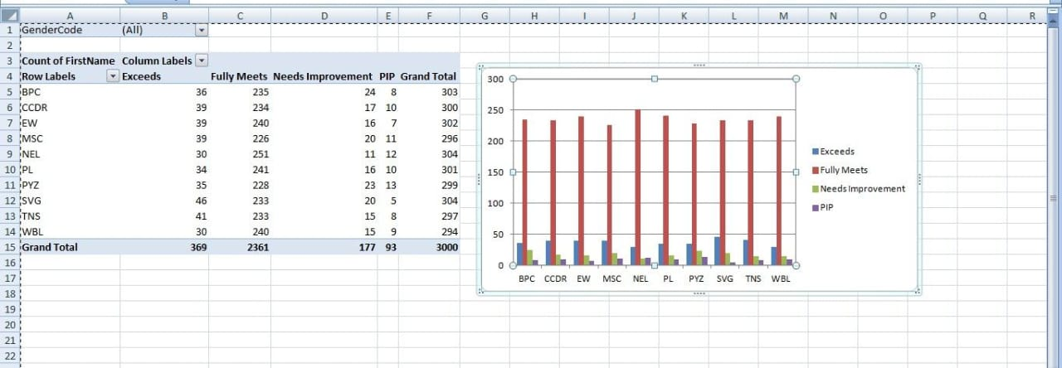
Employee Performance Analysis Using Excel

